Slide 1
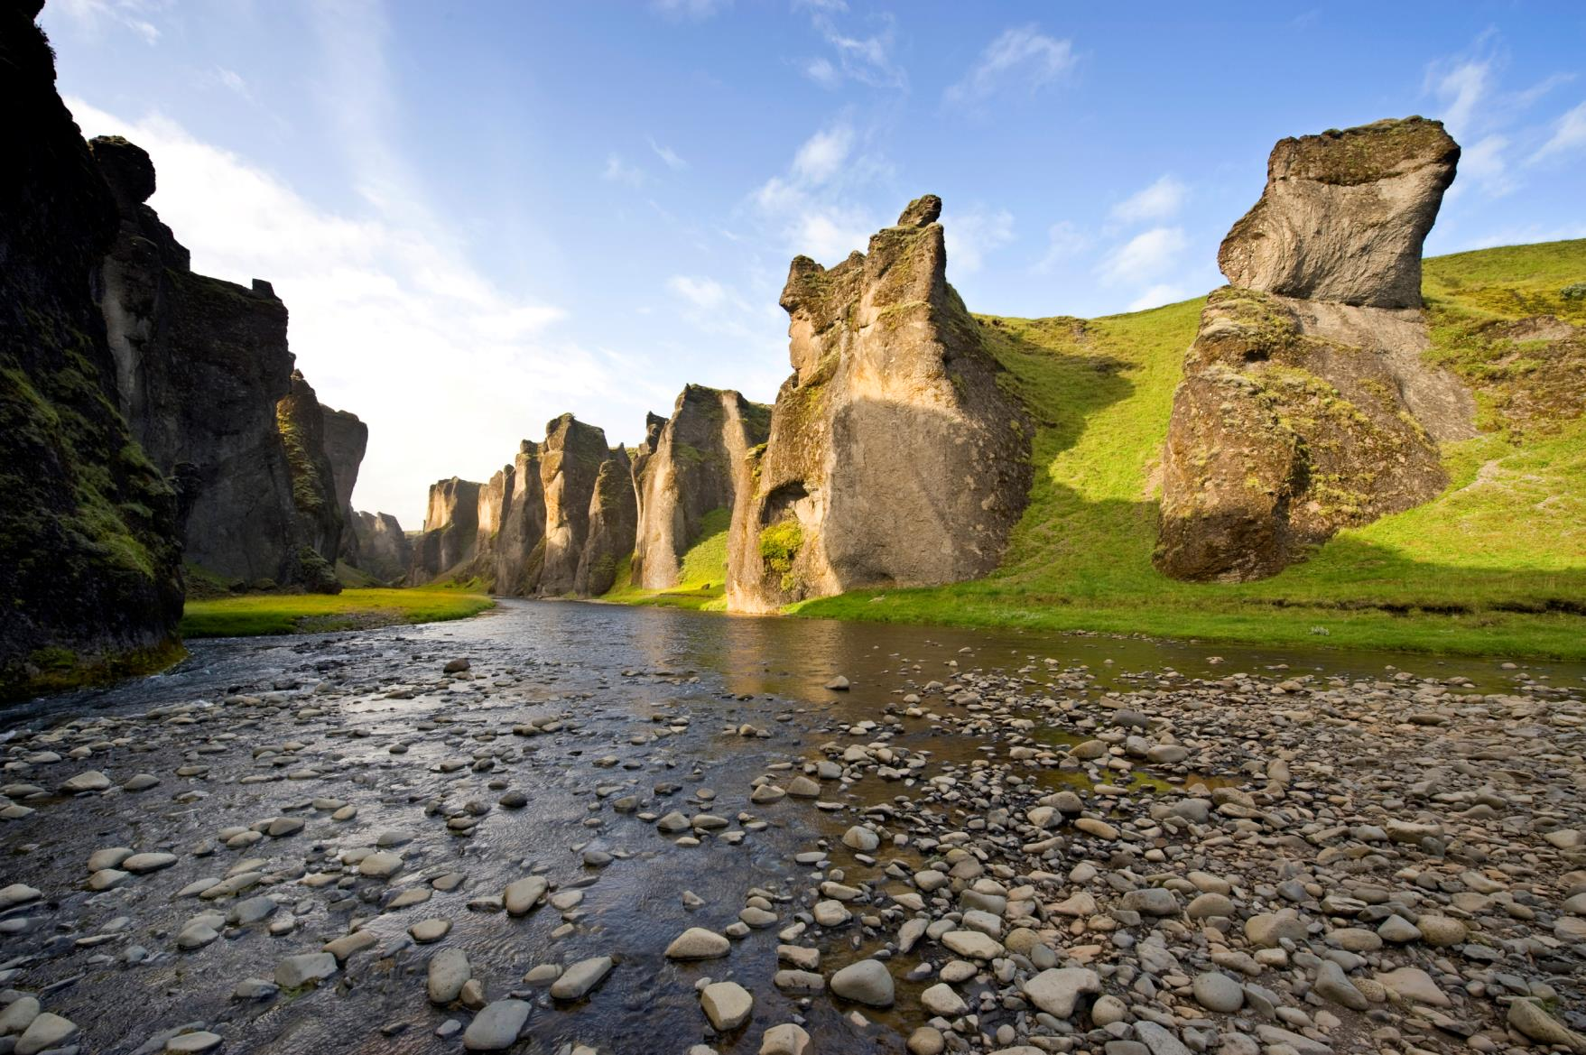
Environment Agency of Iceland

Slide 2
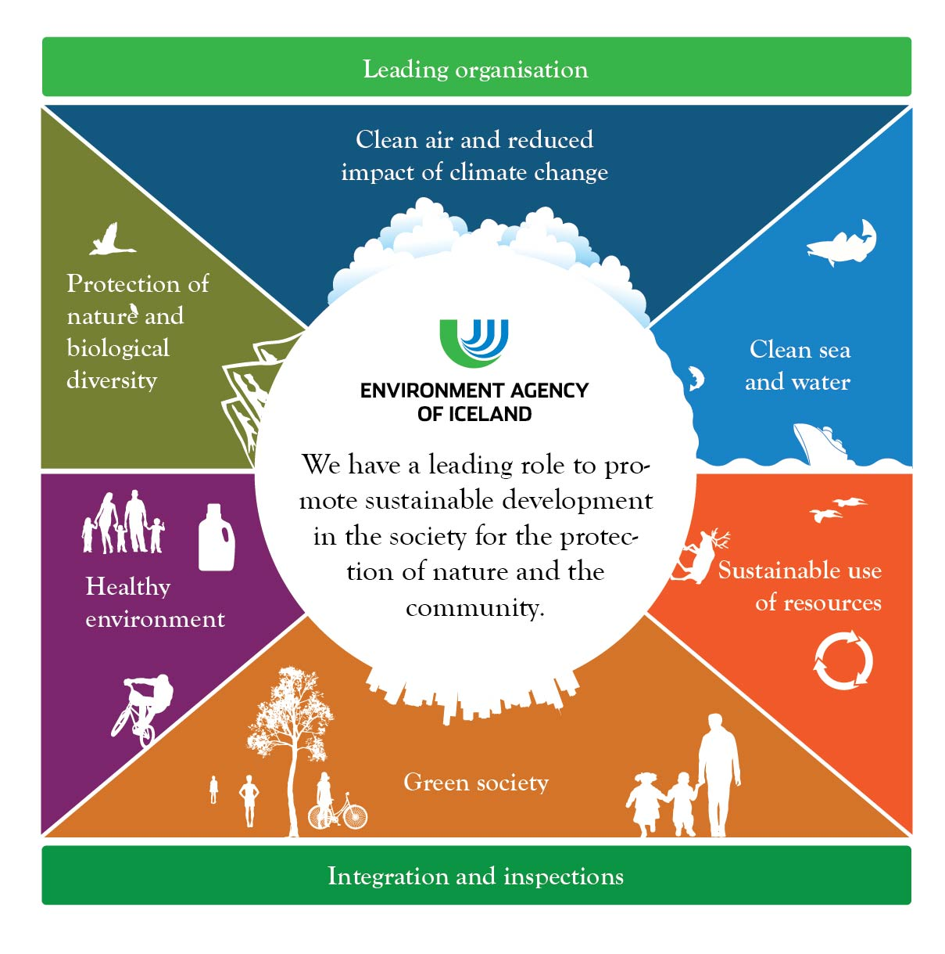
Notes:
5 year stratigic plans laying our our main objectives and how we eill measure our success. plan

Slide 3
Organization Chart

Slide 4
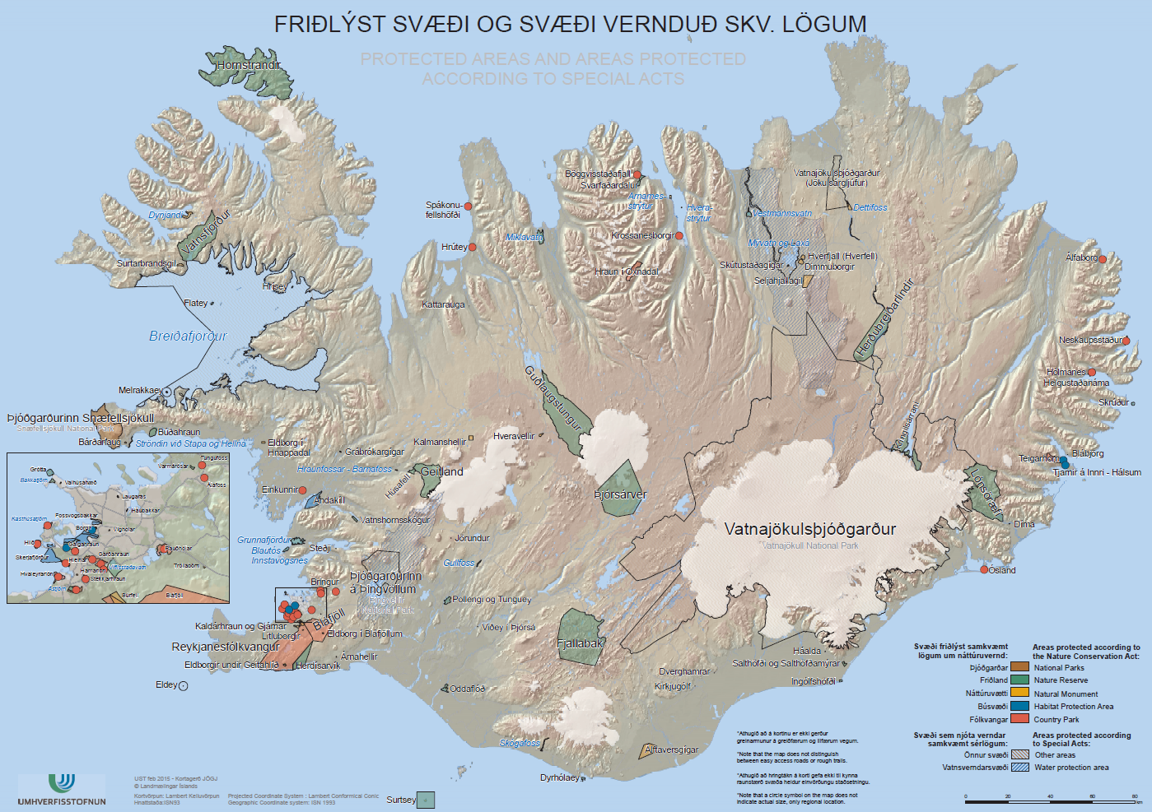
Protected areas
Sunnanverðir Vestfirðir og
Breiðafjörður
Norðurland Vestra og
Norðanverðir Vestfirðir
Norðurland Eystra
Austurland
Þjóðgarðurinn Snæfellsjökull
og Vesturland
Miðhálendið,
Gullfoss og Geysir
Suðvesturland og
Vestmannaeyjar
Suðurland

Slide 5
Nature based tourism in the highlands
How do we best protect the nature now and in the future
The Agency has put forward some reservation towards forming a national park in the highlands to the Parliment
Why:
National Parks is to invite people to the area
Large parts of the highlands are very sensitive, the growing season is very short
Friðland að Fjallabaki is in a more strict protection category
If
Very clear on what are the aims with the park, (Not just the biggest….)
Very strict rules on tourism in the park (Snæfellsjökull national park is making their own Toruism steering plan) based on The European Charter for Sustainable Tourism in Protected Areas

Slide 6
Nature based tourism in the highlands
Need to answer several questions
Management of the national park
Sustainable park what does it mean
What do we allow within the park, for grasing, power plants, houses owned by private actors, visitors centers, hotels, helicopters, camping,
Waste (all goes out of the area), sewage (closed systems), Use of chemicals,
Security, when are tourist allowed in the highlands, under what conditions.

Slide 7
Nature based tourism in the highlands
Need to answer several questions
Management of the national park
Linking to the local people
Links to local governments who have the planning power
Who are allowed to have operations in a protected site
Licensing and fee
Funding of the management of protected sites, fees, the tax base
Closing of sites in different times

Slide 8
Nature based tourism in the highlands
Lessons from the protection Team:
this will take time, need of a timetable that everybody are in agreement on
At the same time make the management plan
And tourist management plan
How to make sure that local people are positive

