Slide 1
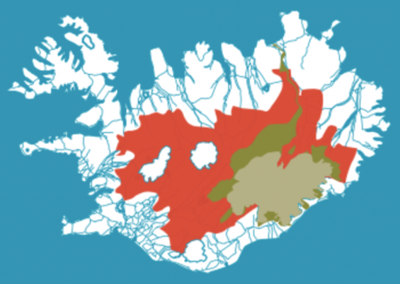
Breaching the Gap Between Laissez-fair Attitudes and Planning
Kristín Vala Ragnarsdóttir
Institute of Earth Sciences, vala@hi.is
Highland National Park: Opportunities to Link Tourism and Conservation
Linking Tourism & Conservation
Hraueyjar Guest House, Iceland

Slide 2
Earth’s Life Support System
Society
Economy
Quantifiable Nature Capital
ASAP, Costanza et al. 2014

Slide 3
“Þetta reddast”
A very typical Icelandic attitude
It means – well we have not planned it but it will be ok, we will make it happen - and generally it does…
Compare and contrast with Swiss planning

Slide 4
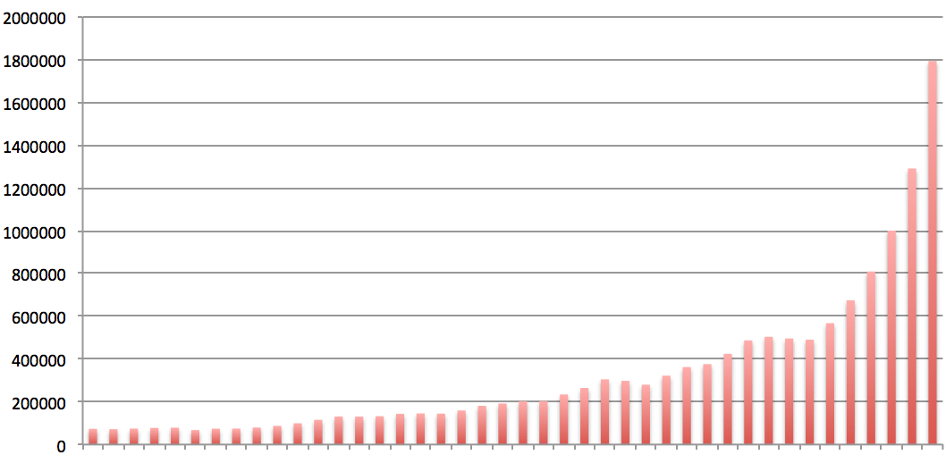
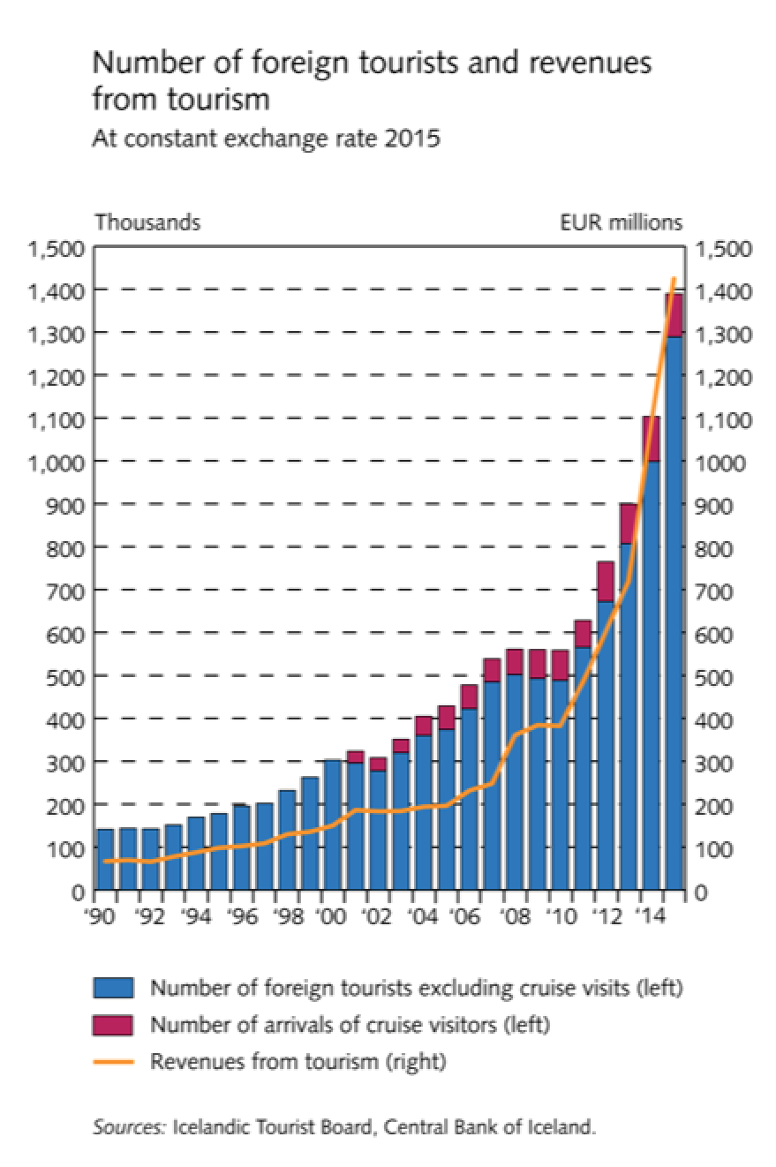
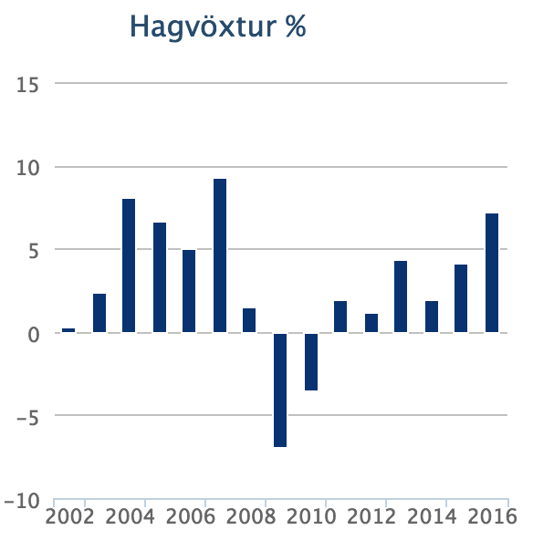
Annual number of tourists
GDP
2016
2008
2000
1975

Slide 5
USA National Parks
Entrance fee - $7.0 per person per day
Reservations usually required
Federal Recreation Passes
Annual pass $80 (two people can sign the pass – up to 3 people 16 and older can travel)
Regional passes $60 (up to 3 persons with pass holder)
Free for 15 years and under
Fees used for managing park, provide visitor facilities and services…
Special 7 day charge for vehicles - $30 for cars

Slide 6
Bhutan
Everything has to be booked before coming
Hotels etc
You need a visa ($40)
You can only travel around with a licensed Bhutanese tour guide
You pay a tourist tax of $65 (sustainable tourism royalty)
Goes toward education, healthcare, poverty alleviation, building infrastructure

Slide 7
Switzerland
Tax is used for tourist infrastructure
Transportation, information services, cultural performances)
Referred to as visitors´ taxes
Paid per person per night
Varies from town to town, season to season and according to type of accommodation
Typically $4.5-7.0 per person per night (sometime with citizen´s pass)
Children 6-16 half price
Swiss people pay the same tax

Slide 8
Other countries we can learn from
Norway (Svalbard)
Finland – one governing agency

Slide 9
Compare and contrast with Þingvellir National Park
Anyone can enter whenever they wish
No local guide required
No National Park fee
Fee for parking and toilets (new)
I have seen 20 buses and a few hundred cars there at the same time
That makes more than 1000 people
“Þetta reddast” is not working any more...
“Þetta reddast” will not work for a Highland National Park

Slide 10
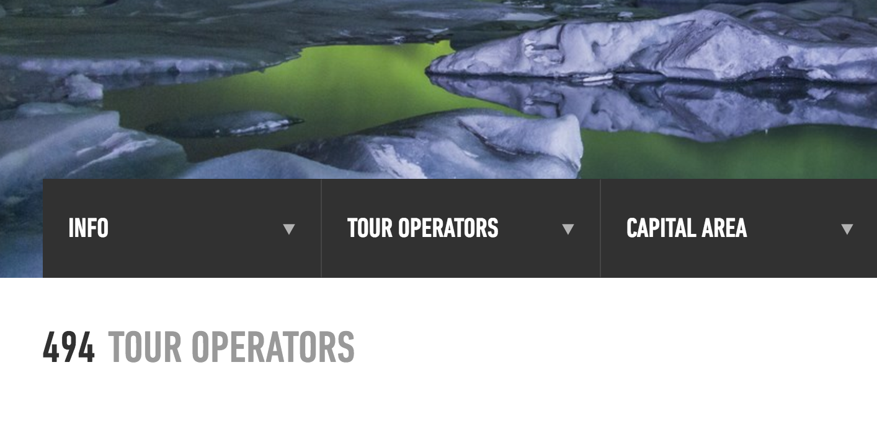
7 operators have the license to take people
diving/snorcling at Þingvellir…

Slide 11
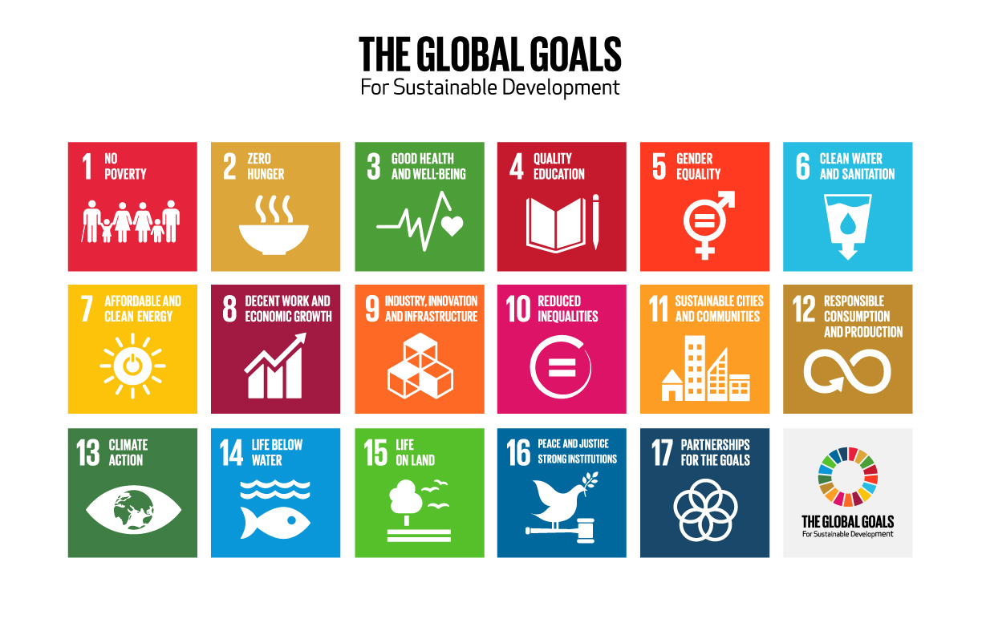
THE SDGs
2015-2030
also known as
GDP
The SDGs have framed a much broader interpretation of “progress” than traditional GDP

Slide 12
Planetary Boundaries
Overall Goal:
Sustainable, Prosperous, and Equitable Well-Being
for humans and the rest of nature
Basic Human Needs
(subsistence, reproduction, security, affection, participation, leisure, creativity, identity, freedom, etc.)
Subjective Well-Being
(moderated by happiness skills)
New Development Paradigm
Ecological sustainability, fair distribution, regenerative economy, living democracy
Capital Assets
Natural, Built, Human and Social (including financial)
ASAP - Costanza et al. 2014

Slide 13
Nature regeneration/
Environmental protection
Ecosystem and human
wellbeing
Business
environmental
responsibility
Society
Of
Wellbeing
Major
Activity:
Achievement
of SDGs
Sustainable tourism
Nature education
Regenerative economy
Inequality
reporting
Healthy citizen
Internationally active
Living democracy
Integrative governance
Stakeholder engagement
Sustainable transport
Maps of electoral programs
Nature has human rights
(Bolivia, Equador, New Zealand)
Sustainability in constitution
(Namibia, Costa Rica)
AtKisson’s Compass

Slide 14
Tourism and nature conservation
Linking the tourist industry and nature conservation
Key to a sustainable future
We need to learn from other nations
Need to tax accommodation and entry into national parks
Use revenue to build infrastructure + fund rangers + information centres
Need to operate within nature and social sustainability limits
Indicators need to be developed and agreed
There must be careful planning for
Tourism in general and the Highland National Park
… and one governing agency

Slide 15
Thank you!
Now lets discuss…

Slide 16
Carrying capacity being exceeded
Nature
Paths, lack of paths, lack of time/location planning…
Tourist guides are ranking Iceland much lower in 2017 than a few years ago
Society
Tourists have taken over…
AirBnB
There are thousands of “imported” people working in the tourist industry
There are sad stories about them being treated badly
Has an effect on the rental housing market
Thousands of people hired in from abroad
Economy
Road upkeep in shambles
Reason for economic growth in Iceland but revenue not used for infrastructure (with small exceptions…)

Slide 17
VAT on accommodation
Good idea (from my perspective)
How is this charge used?
Aim to increase in 2018
It should be used to build local infrastructure!
Charges for entering National Parks needed
Some Icelanders don´t like it but that should not prevent us from doing it
So my question is - Is there a plan?
Very badly needed: Control of tourist numbers in popular areas

Slide 18
Way forward
Use accommodation tax and National Park entrance fee to build up infrastructure and increase number of highland and natural park rangers
Build visitors centres with adequate services and information
Limit numbers of tourists in time and geographic areas
Carefully monitor societal wellbeing and tolerance of tourist industry
The Krona is far too strong so Iceland is now very expensive – is that a good thing for limiting numbers?
Monitoring must be on tourist industry to follow regulations (tax etc)
We need to pay attention to our reputation abroad

Slide 19
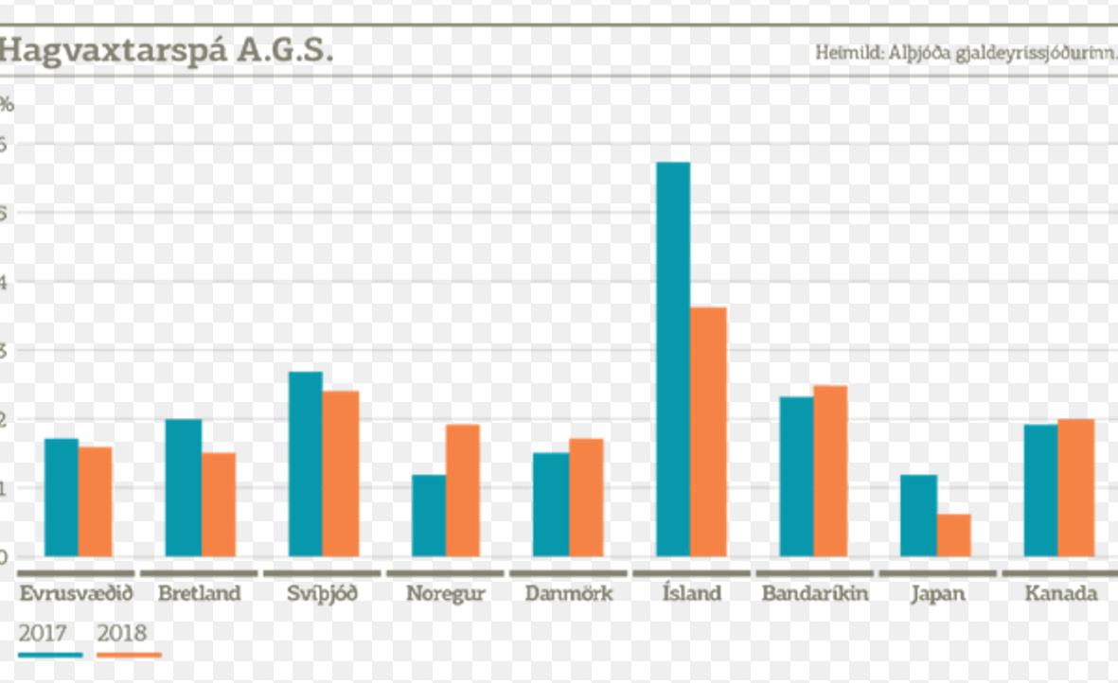
Contribution to GDP
GDP prediction
GDP 2016
Tourism in Iceland 6%
With indirect effect 10%
Industry 10%
Fisheries 11%
6%
IMF

